Slide 1

By:
G. Nithin (1602-20-737-149)
J. Pavan kumar (1602-20-737-151)
a. Pranesh yadav(1602-20-737-152)

Slide 2
ABSTRACT
This is a project on converting an image to an excel sheet. To be more precise, converting a scanned image of rows consisting of data into an excel sheet without any discrepancies in the data. This project was done by installing necessary python libraries and APIs such as Microsoft Azure Computer Vision API. In this process of conversion first, the scanned image should be converted into a form of text and then the text can be converted to an excel sheet. In the conversion of the scanned image into text, the OCR(Optical Character Recognition) or the API will recognize every character of the image and converts into a form of text, then we store the text into a text file and by using python library "openpyxl" we convert the text file into an excel file. A GUI(Graphical User Interface) dialog box will appear in which the user should drag and drop the required image and the required excel sheet to get the contents from the scanned image into the excel file. Our project will help all those people who find difficulty in entering each and every character into an excel file looking at the hard copy of the content. Especially for the faculty members of schools or colleges or any individual who deal with data consisting in the form of rows and columns.

Slide 3
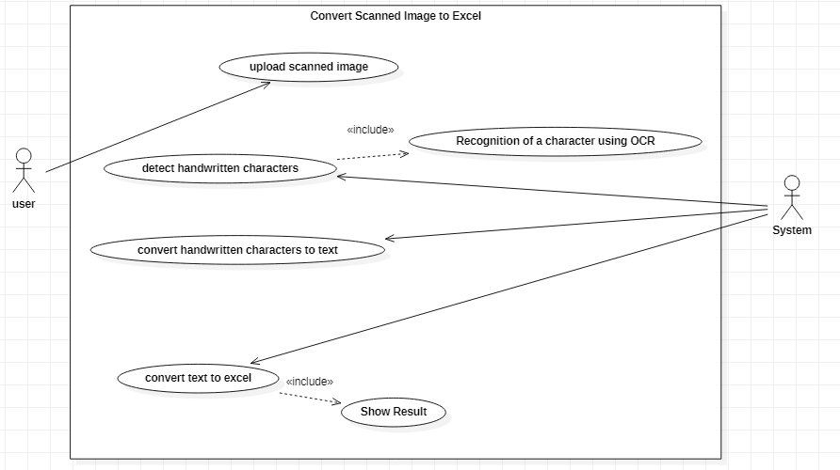
Use-Case Diagram

Slide 4
TECHNOLOGY USED
API LIBRARIES USED:
from msrest.authentication import CognitiveServicesCredentials
from azure.cognitiveservices.vision.computervision import ComputerVisionClient, operations
from azure.cognitiveservices.vision.computervision.models import OperationStatusCodes,VisualFeatureTypes
PYTHON LIBRARIES USED
from PyQt5 import QtCore, QtGui, QtWidgets
import re,os,sys
from PyQt5.QtWidgets import *
import pandas as pd
from openpyxl import Workbook, load_workbook from openpyxl.utils import get_column_letter
from PyQt5.QtCore import Qt

Slide 5
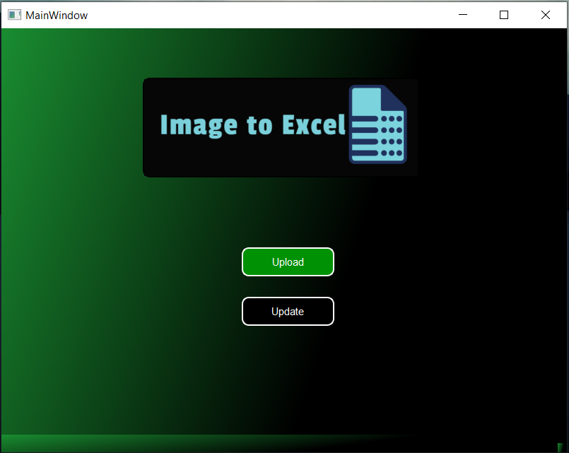
EXECUTION SCREENSHOTS
Main Window

Slide 6
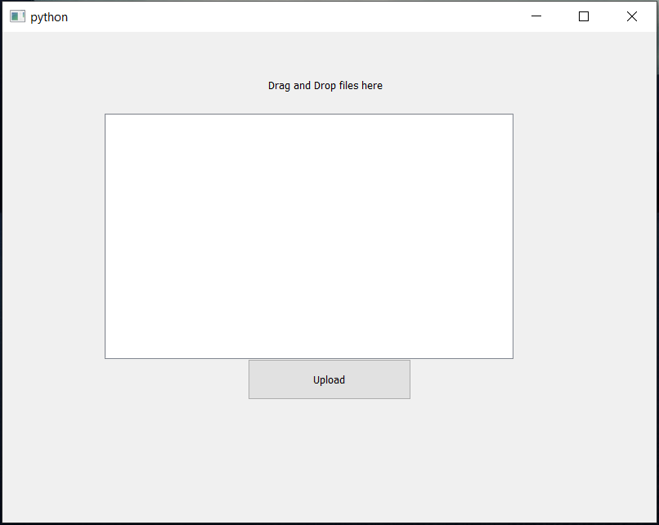
Uploading image

Slide 7
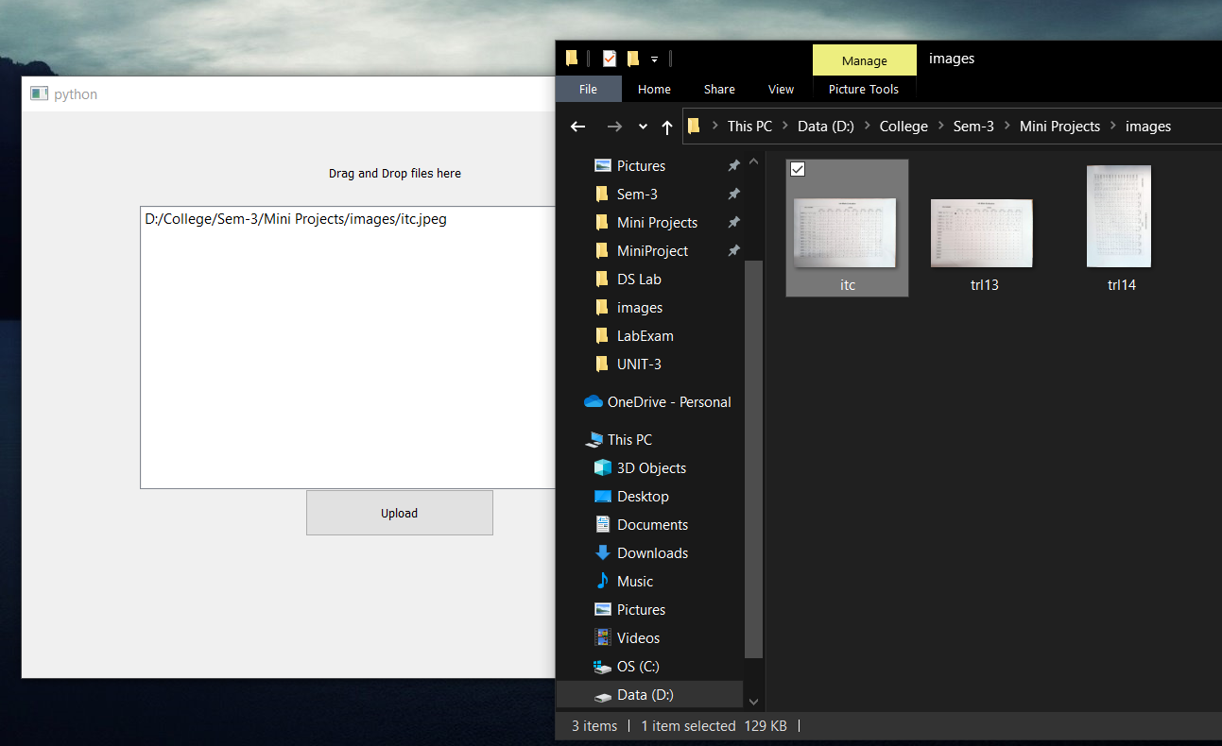
Drag and drop image

Slide 8
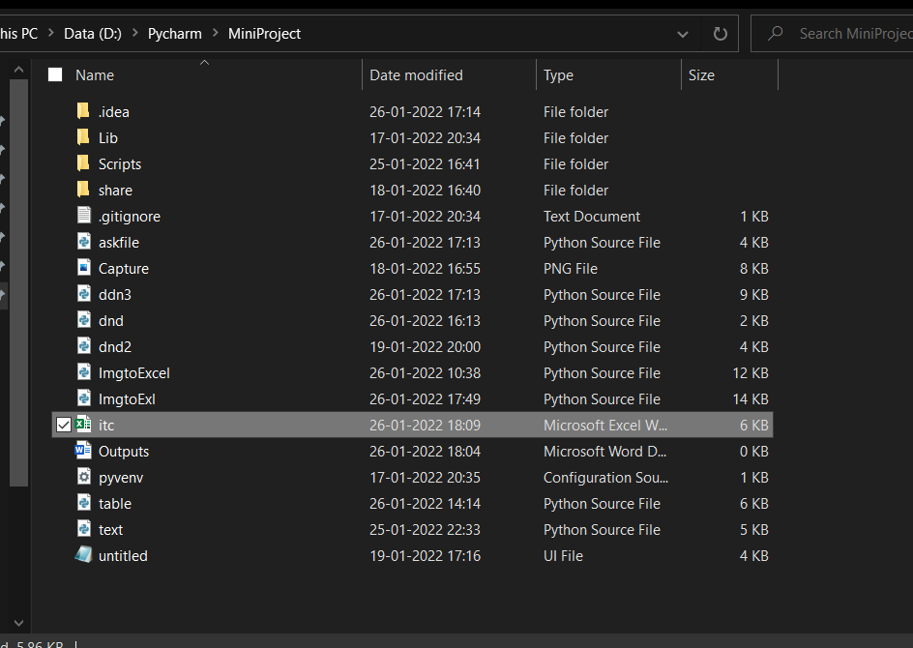
Output in form of Excel in folder after uploading

Slide 9
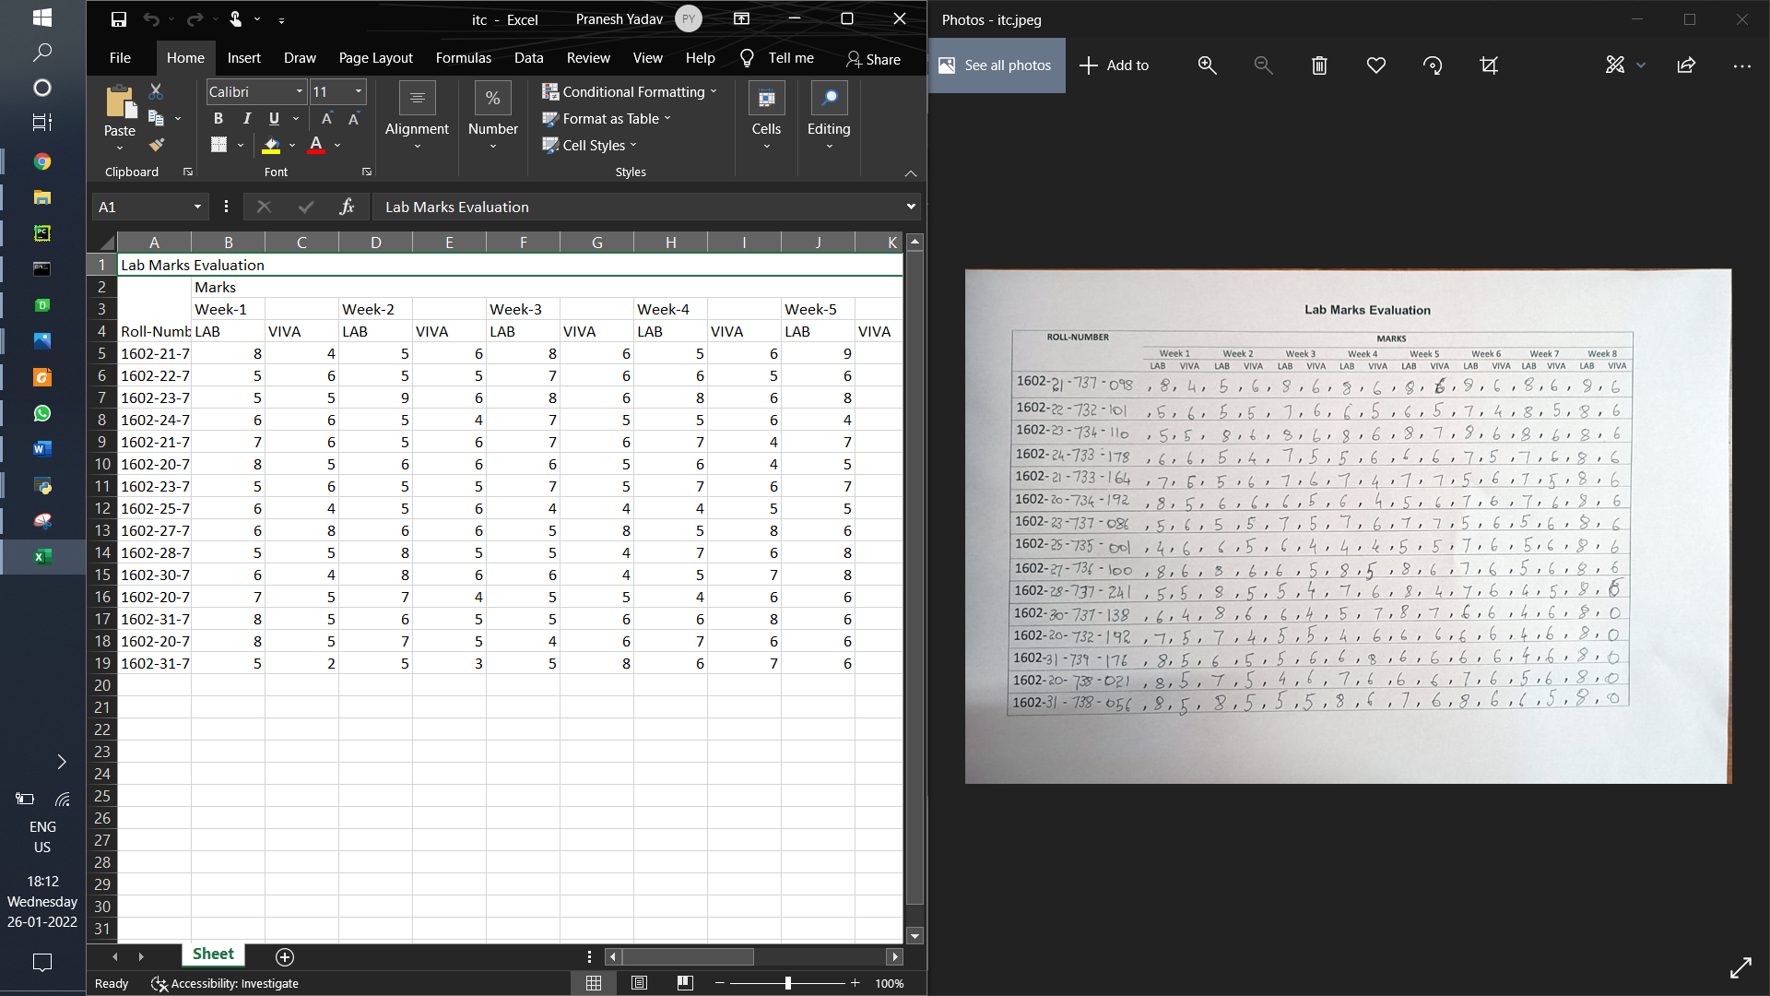
Output In Excel-

Slide 10
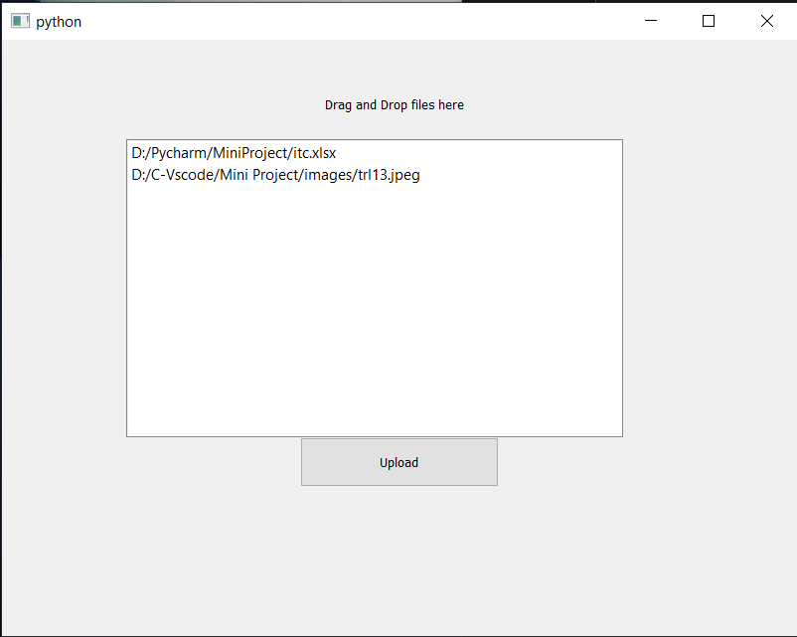
Updating new data to existing file

Slide 11
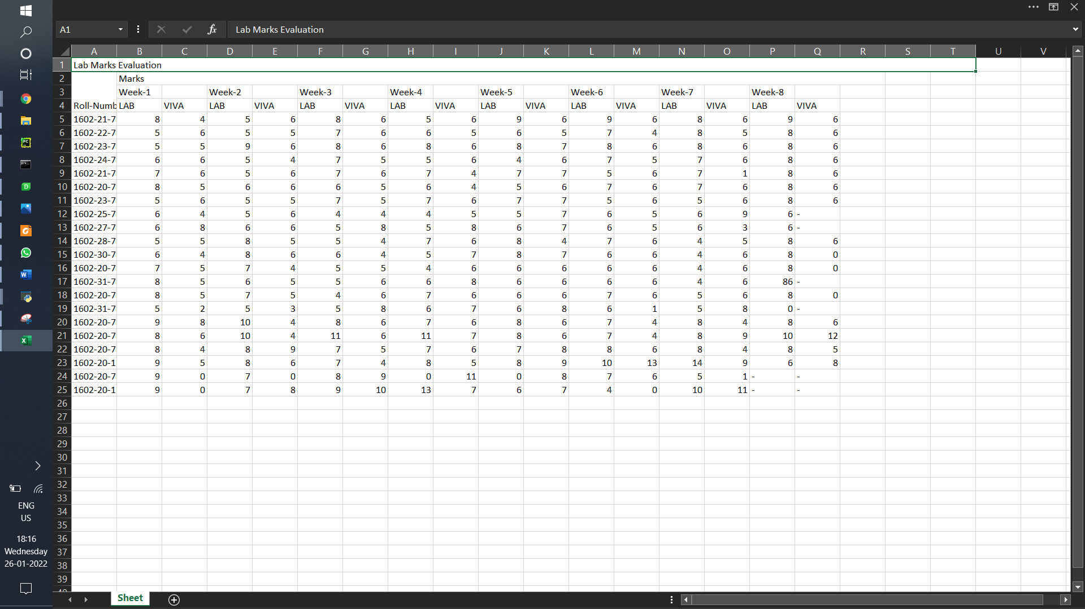
Output in excel-

Slide 12
CONCLUSION
FUTURE SCOPE:
This project can be enhanced and extended major project using Tensorflow 1.3 using Machine Learning (ML) algorithms.
This Software can be easily implemented under various circumstances. We can even add new features as when required.
Our project will help all those people who find difficulty in entering each and every character into an excel file looking at the hard copy of the content. Especially for the faculty members of schools or colleges or any individual who deal with data consisting in the form of rows and columns.
In future government and other private agencies can use our project for that section of the department who deal with data containing rows and columns.

Slide 13
THANK YOU

